Slide 1
Multiclass Classification of Dry Beans
Matthias Rathbun

Slide 2
Project Goals
Seed classification is essential for both marketing and production
Additional information and knowledge in their production
Quality control (contaminants)
Dry Bean Dataset
Past performance(Koklu & Ozkan, 2020)
93.13% with SVM
PCA, TSNE, UMAP
Softmax Regression, Random Forest, XGBoost, MLP

Slide 3
Data
Obtained From UCI Machine Learning Repositiory

Slide 4
Overview
16 continuous features, 7 classes
13611 instances
Distributions were skewed
68 duplicate rows

Slide 5
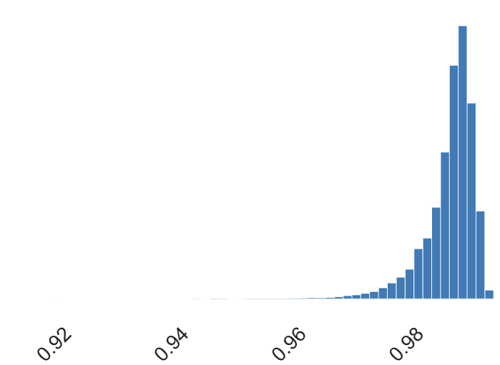
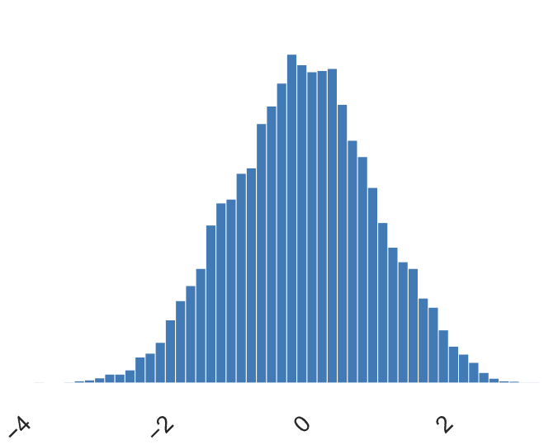
Preprocessing
Duplicate rows were deleted
Data was normalized and power transformed
Normalize feature distribution
Ex: Solidity feature
80/20 train-test split

Slide 6
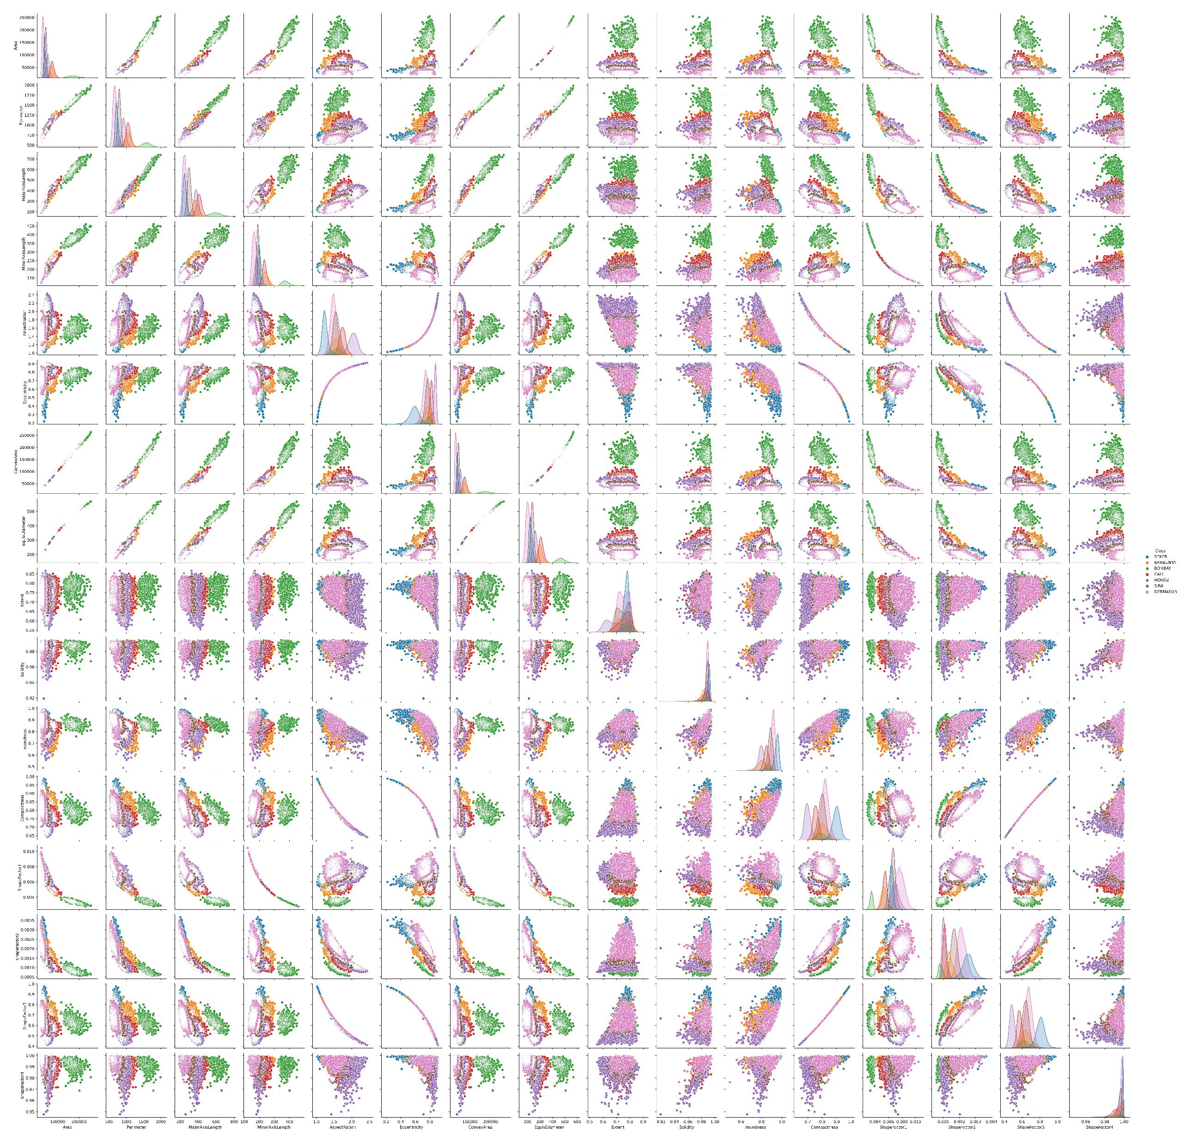
Pairplot

Slide 7
Methodology

Slide 8
Dimensionality Reduction
16 features —> 2 axes
For visualization
PCA-Linear
Preserves linear space
TSNE & UMAP-Manifold
UMAP preserves linear space better than TSNE

Slide 9
Classification
Models fitted on all features
Softmax
10-fold CV
Random Forest
Hyperparameters optimized via Hyperopt
Search Space: (min,max,step)
max_depth: (2,100,1)
min_samples_leaf: (1,200,1)
n_estimators: (10,200,1)
XGBoost
Multilayer Perception (2x)
Via Scikit-learn and Keras
Optimized using KL-Divergence
Evaluation on test set
Confusion Matrix
Classification Report
Accuracy Score

Slide 10
Results

Slide 11
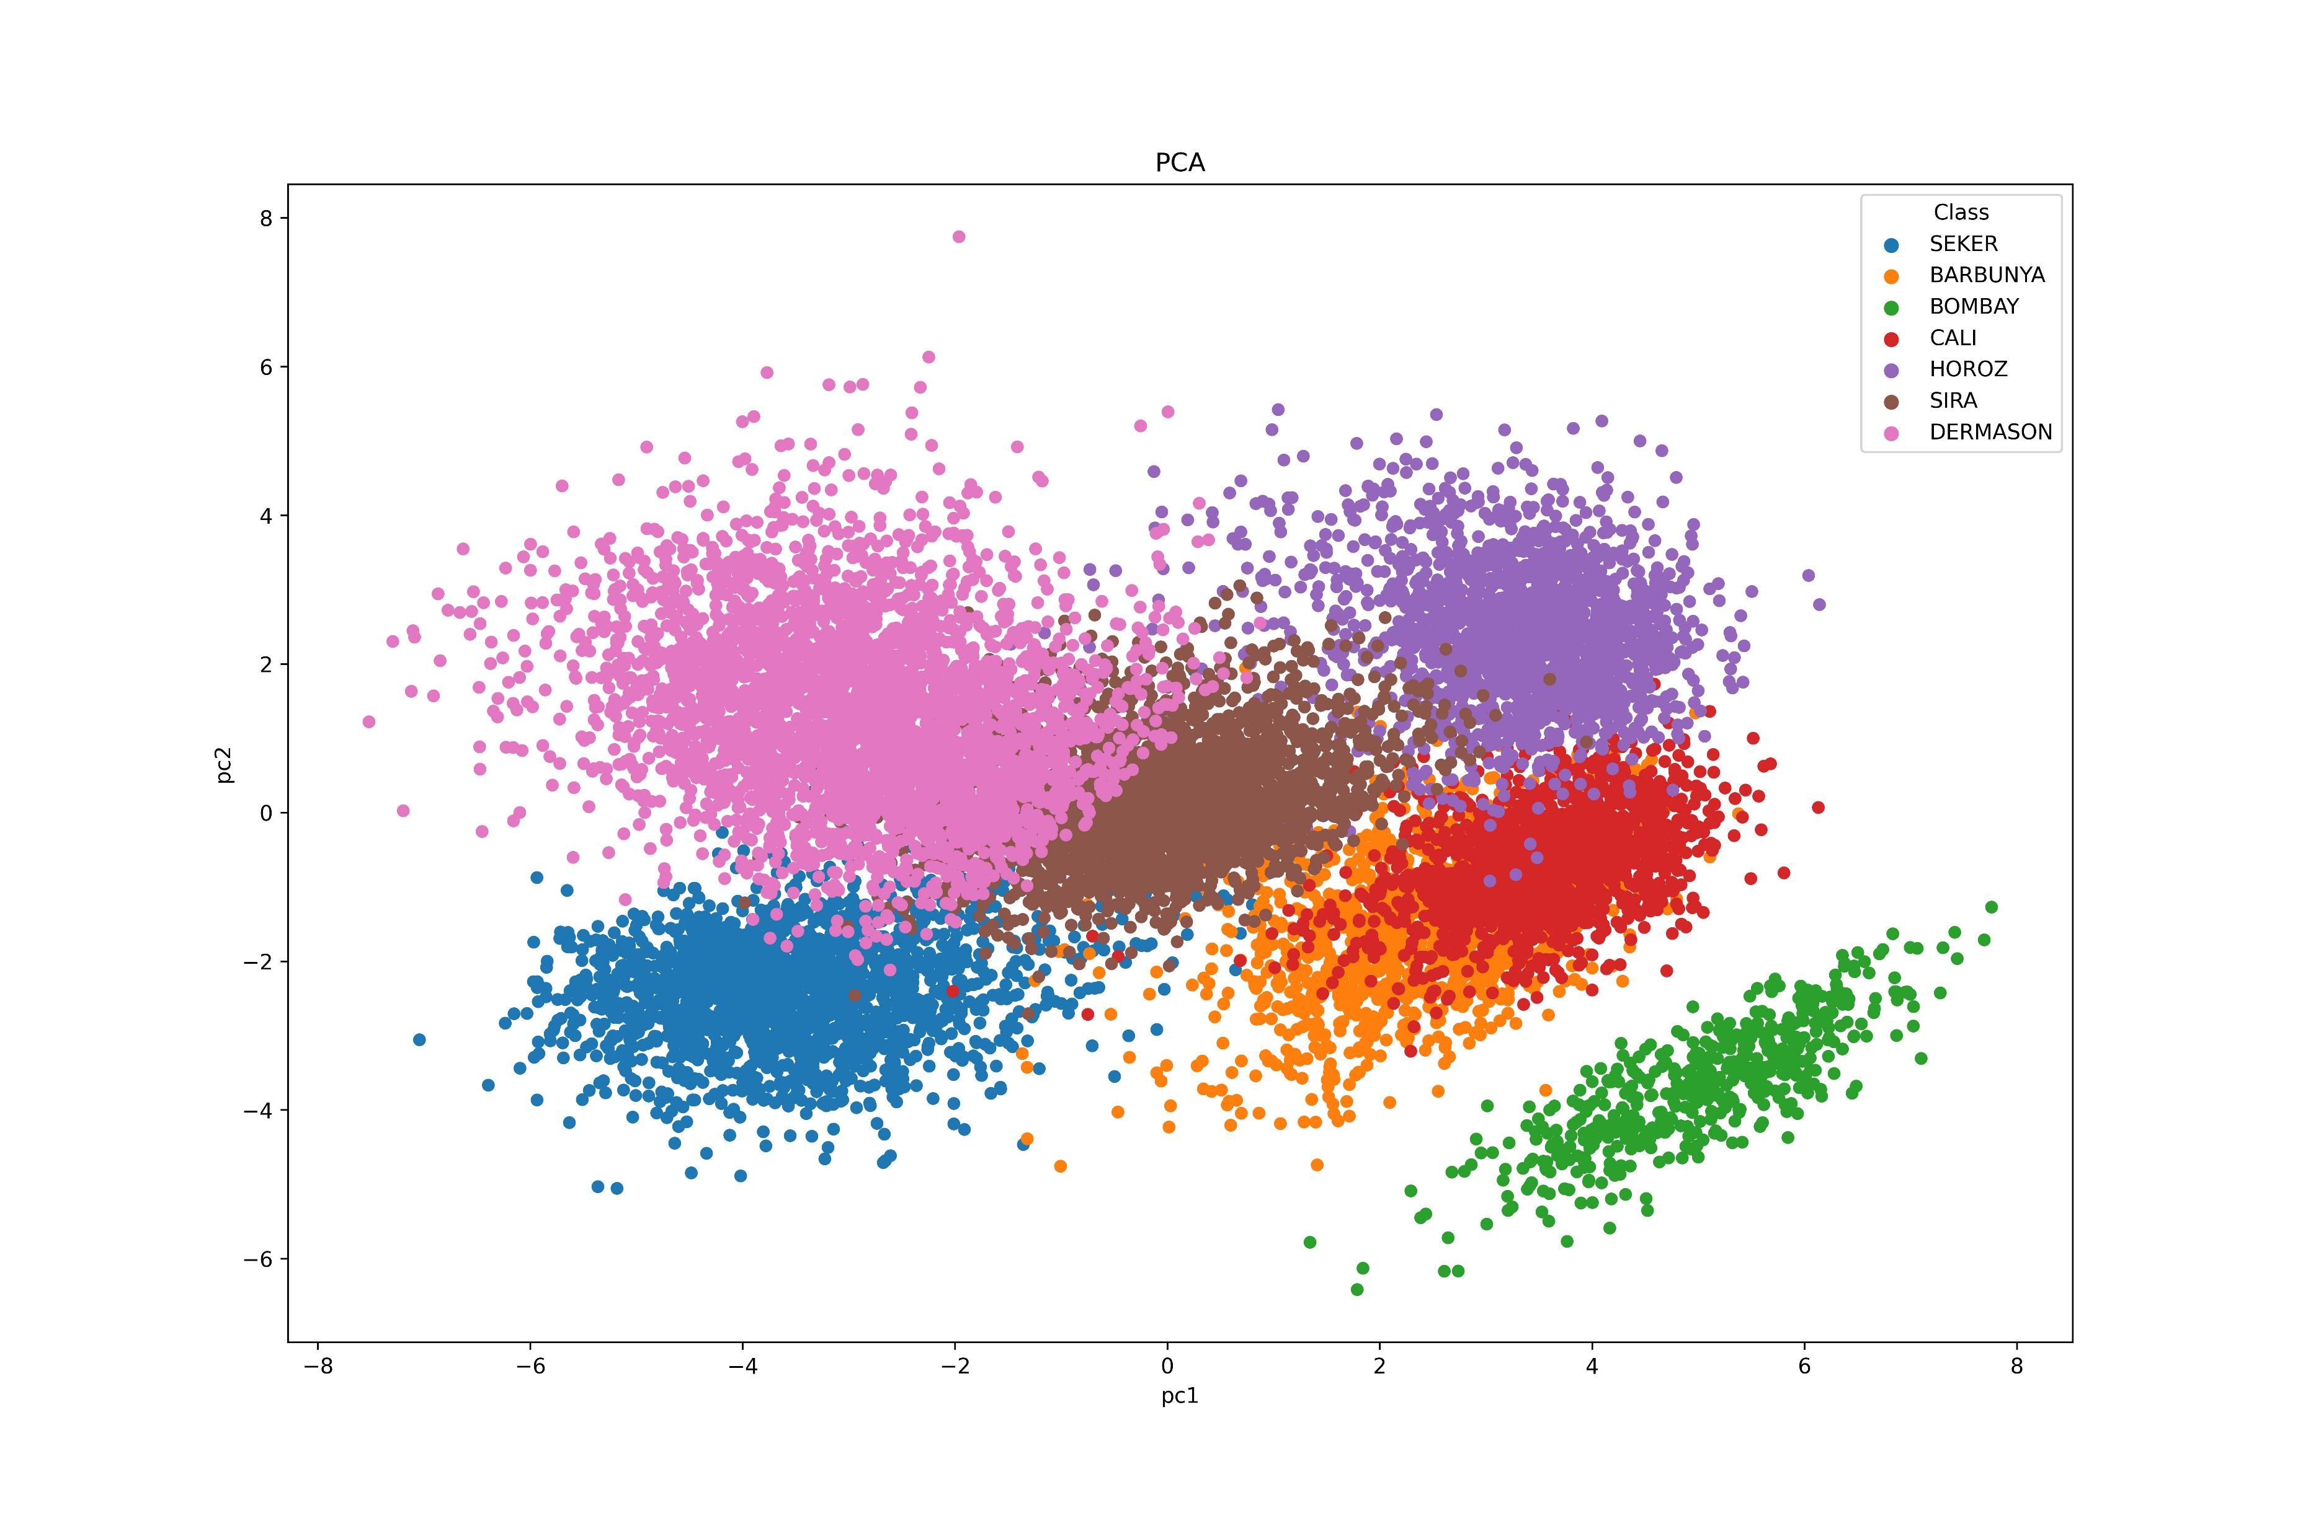
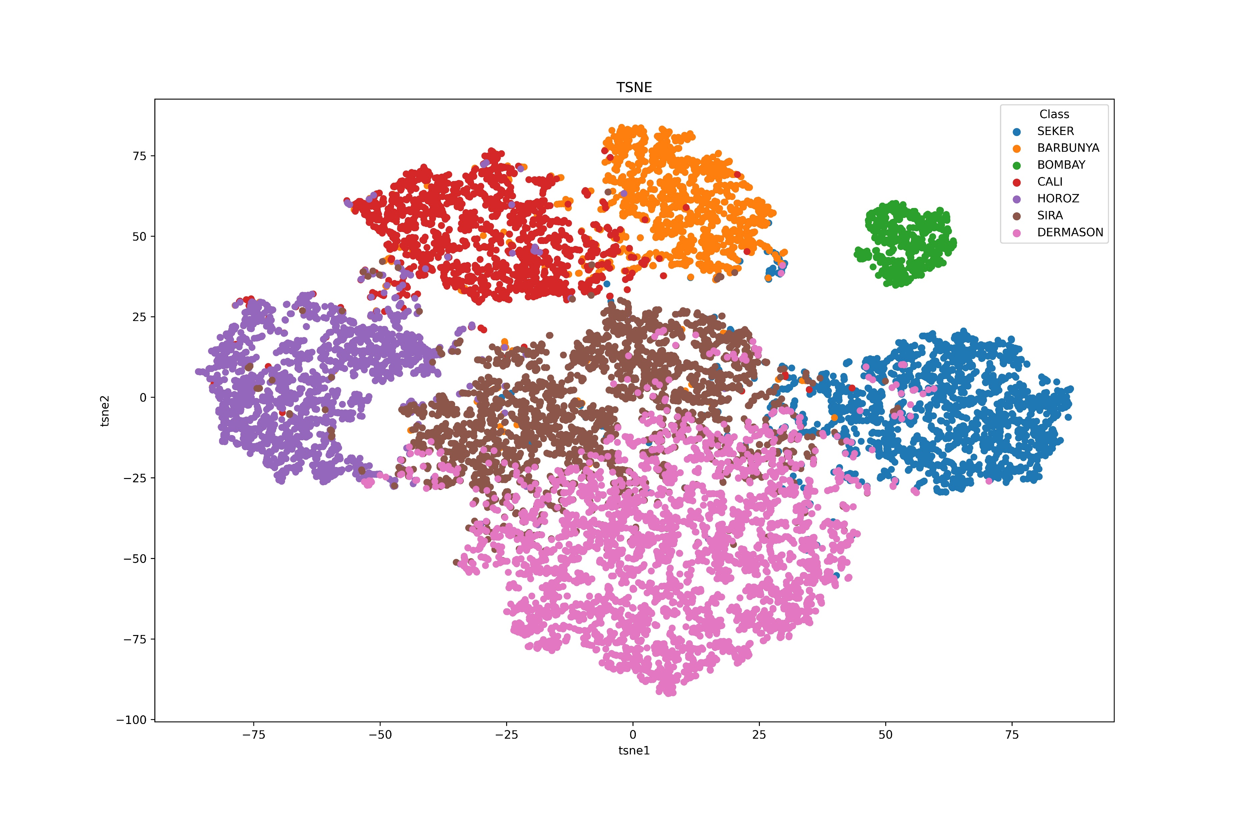
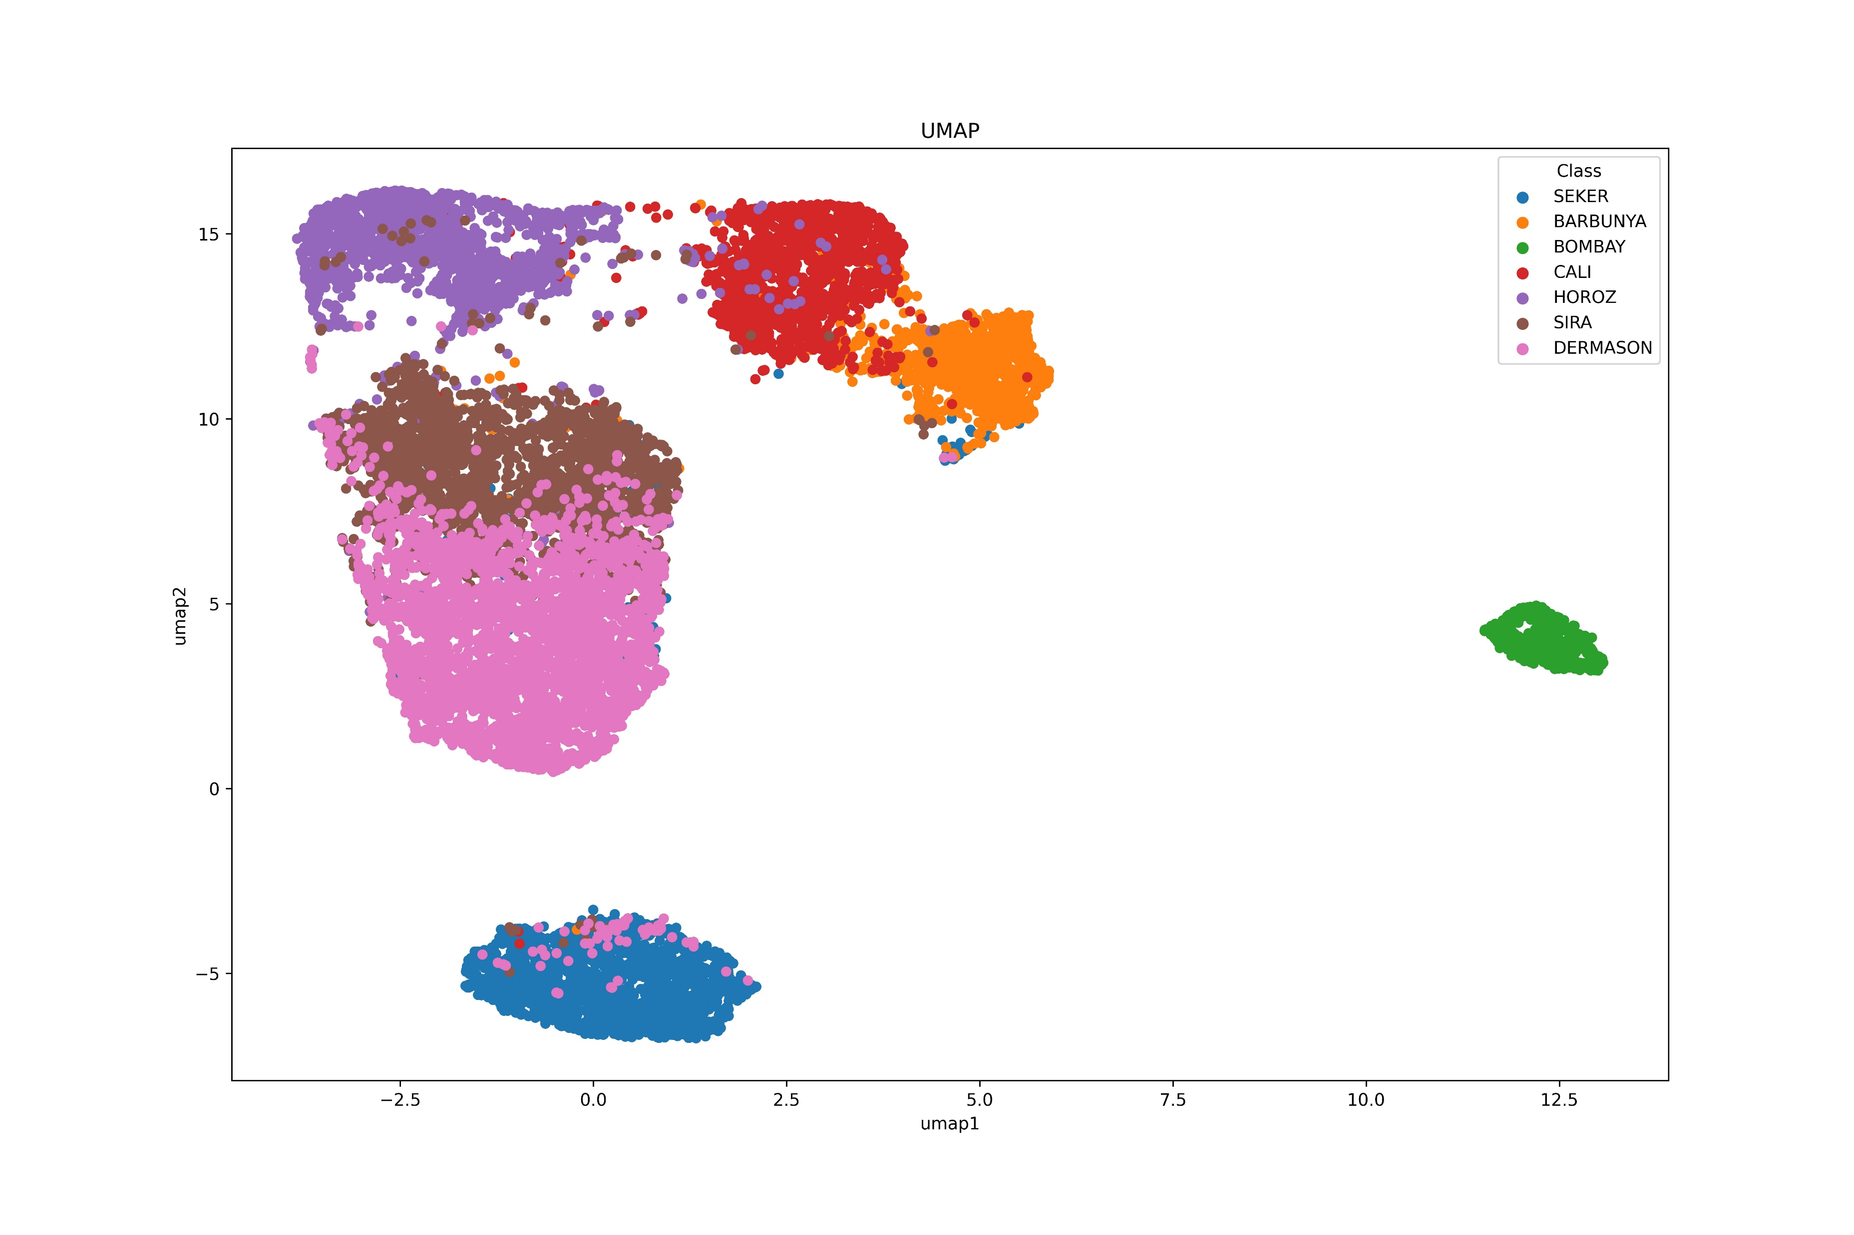
Dimensionality Reduction

Slide 12
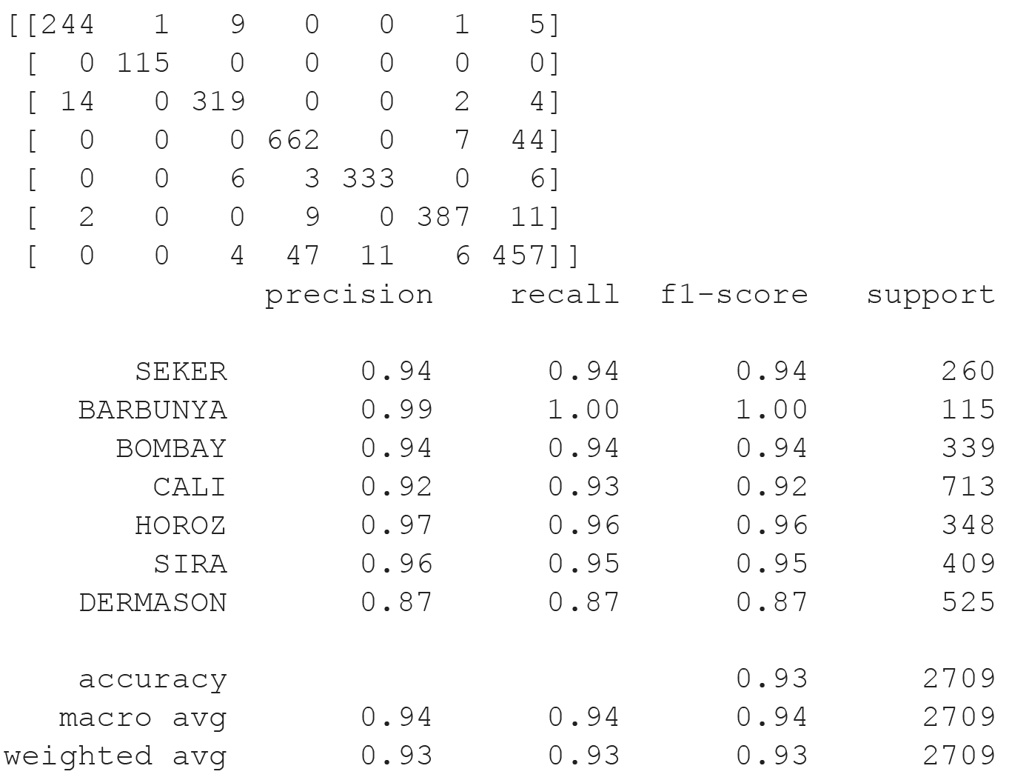
Softmax Regression
Accuracy: 92.91%

Slide 13
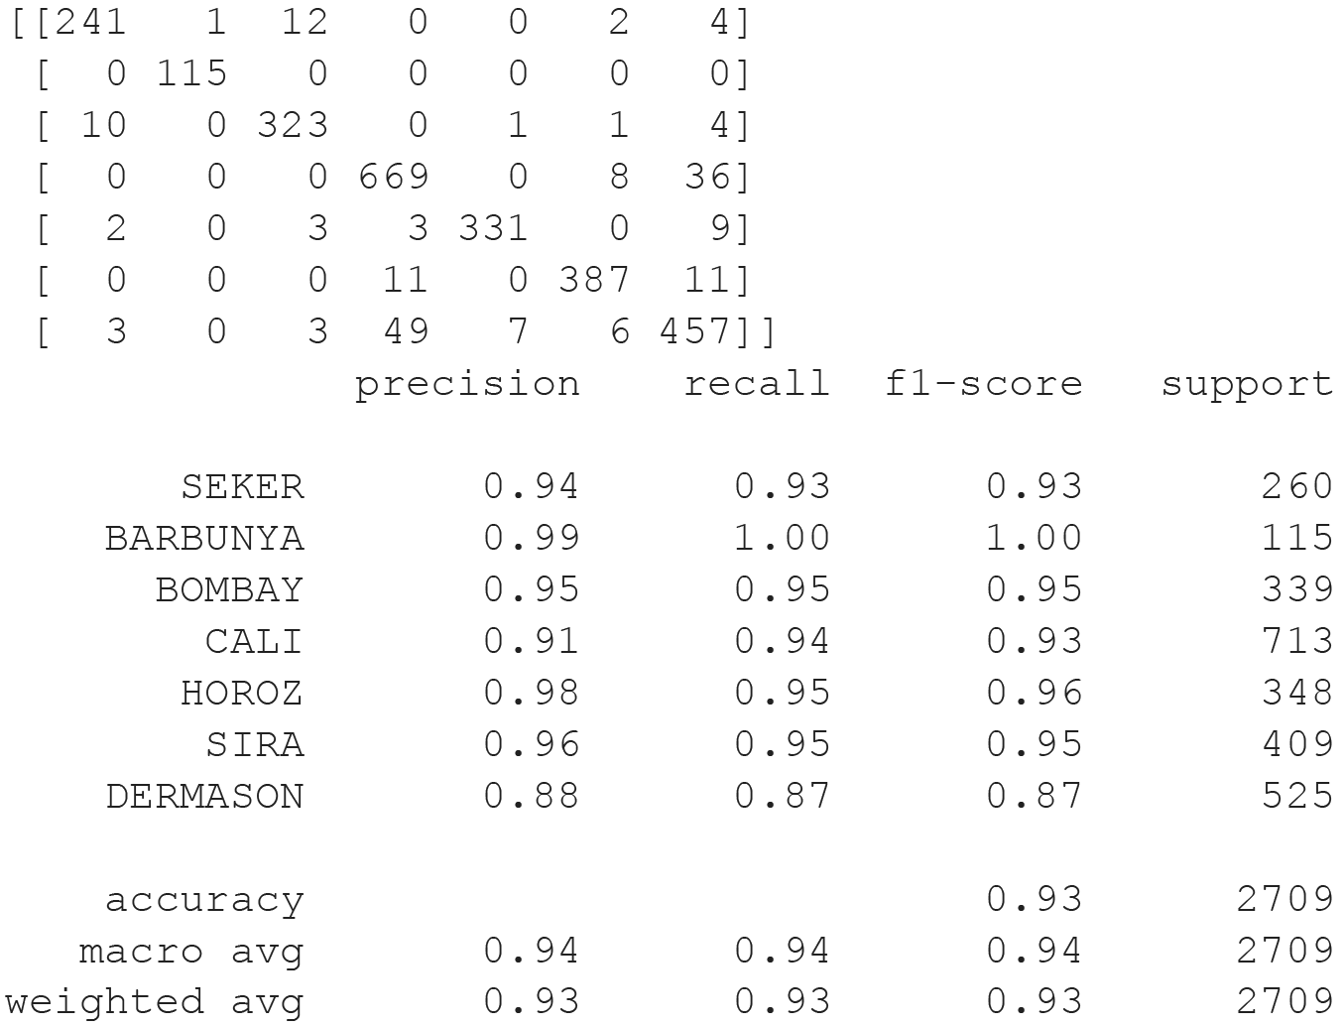
Random Forest
Best parameters
max_depth: 99
min_samples_leaf: 3
n_estimators: 153
Accuracy: 93.13%

Slide 14
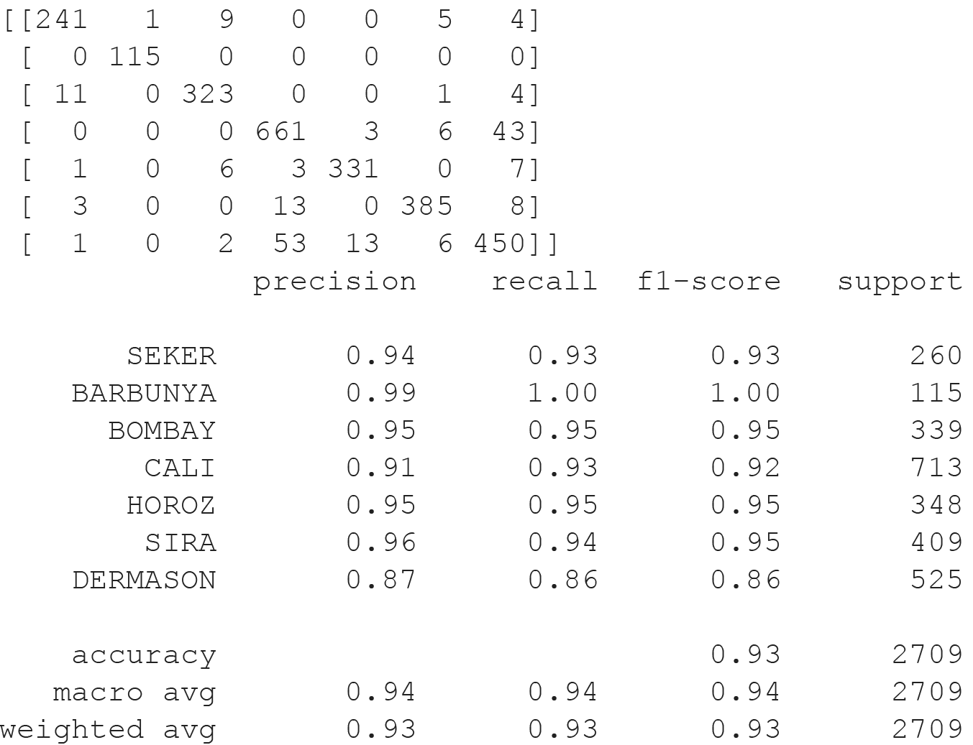
XGBoost
Accuracy: 92.51%

Slide 15
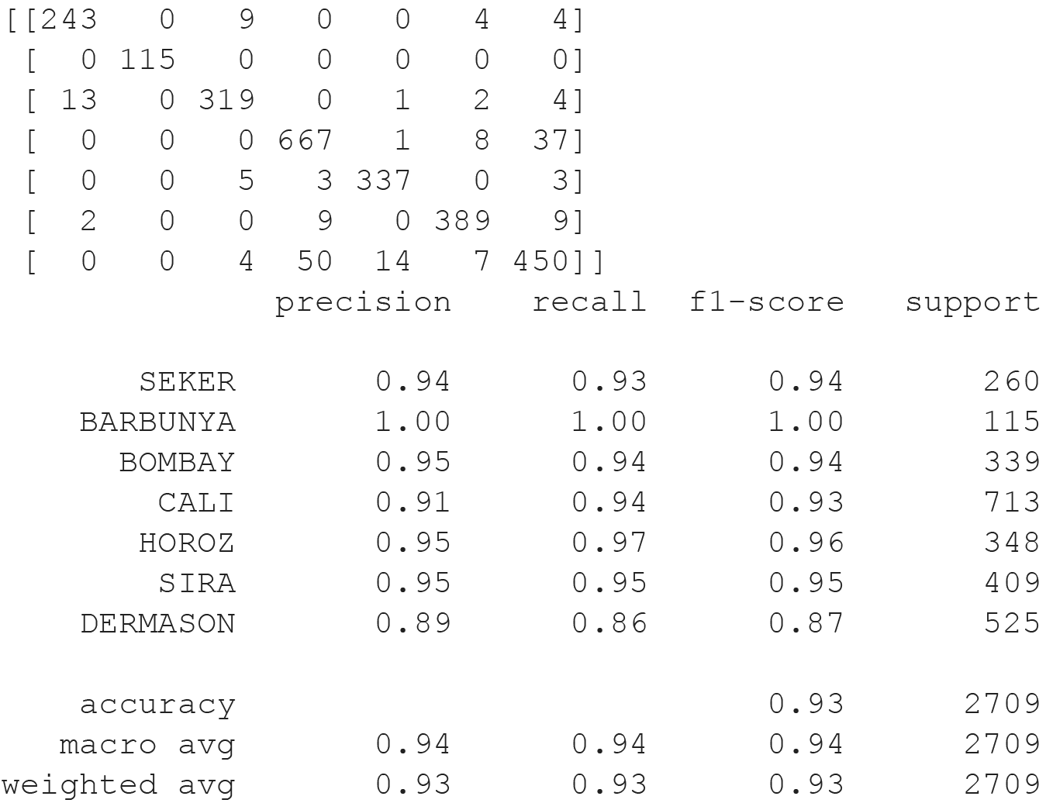
MLP Scikit-Learn
Accuracy: 93.02%

Slide 16
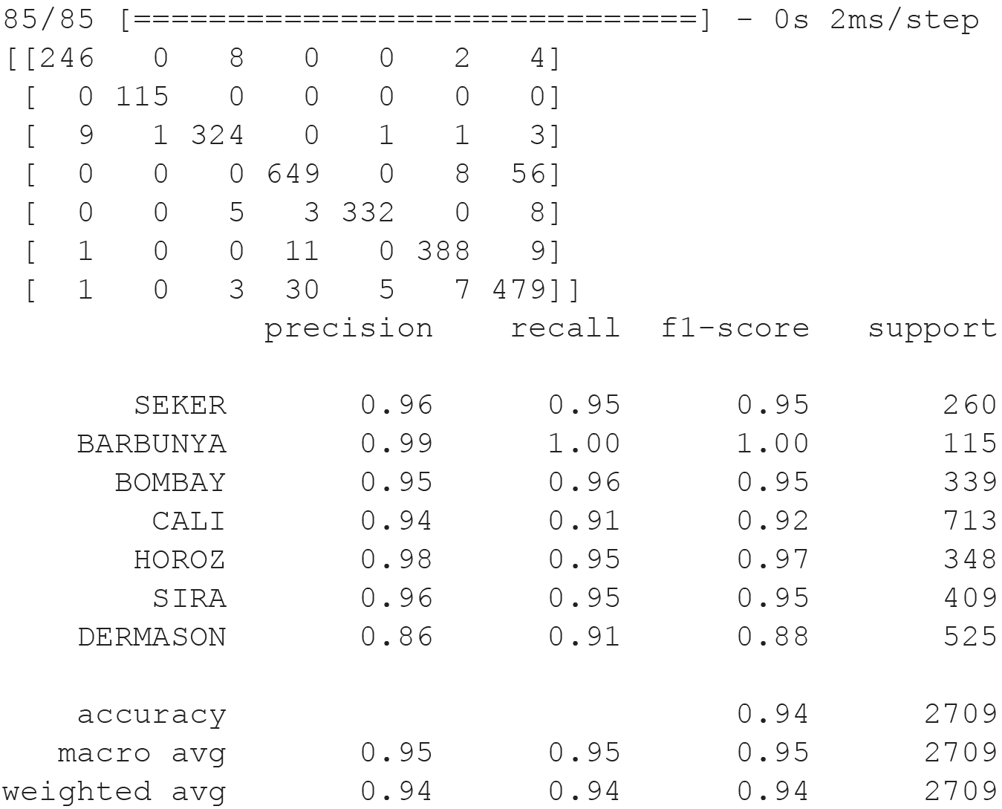
MLP Keras
Accuracy: 93.50%
Model: "sequential_1"
_________________________________________________________________
Layer (type) Output Shape Param #
=================================================================
dense_1 (Dense) (None, 16) 272
dense_2 (Dense) (None, 32) 544
dense_3 (Dense) (None, 64) 2112
dense_4 (Dense) (None, 32) 2080
dense_5 (Dense) (None, 16) 528
dense_6 (Dense) (None, 7) 119
=================================================================

Slide 17
Discussion

Slide 18
Dimensionality Reduction
Separation of clusters
Visualize what the models see.
Sira and Dermason Overlap
Leads to an overlap in classification

Slide 19
Classification
MLP best performance
Outperforms literature SVM model (Koklu & Ozkan, 2020)
All models had issues with Dermason and Sira overlap
MLP customizable
Higher potential accuracy
MLP best model for seed classification

Slide 20
Questions

